Slide 1
BRINGING BACK OLD AMERICANS INTO THEIR HOMELAND
INSTITUTION AFFILIATION
STUDENT’S NAME
DATE

Slide 2

Bringing back old Americans back to their land
During the colonial period, most of the Americans dispersed to many parts of the world. This article, therefore, presents the need for bringing back a group of Americans to support the activities to their homeland.

Slide 3
Importance of modern elders
Elderly mobilizes young to thrive in their adulthood life by encouraging them to engage in various activities such as farming.
Pass cultural transmission from old generation to new generation, impart them with creativity, innovation and leadership skills.

Slide 4
Help institutions grow and multiply new methods to use their talent in solving social problems.
Adults potential help one to focusing in his future ambitions.

Slide 5
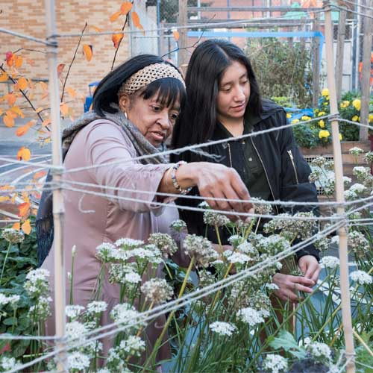
Opportunity 1. mobilizes young people.
Gen2Gen

Slide 6
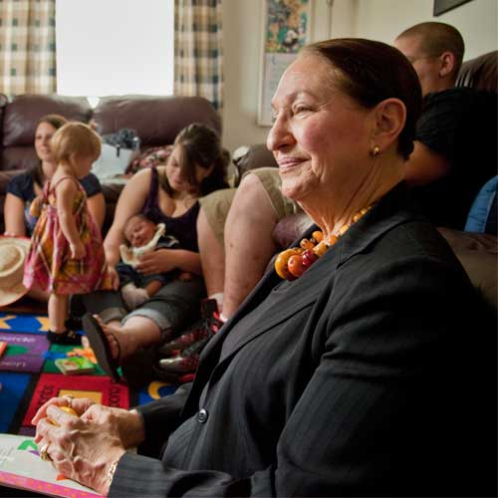
Opportunity 2. Help in institution settings.
Encore fellowship

Slide 7
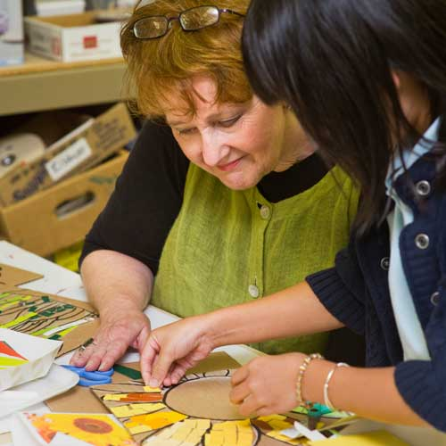
Opportunity 3. Cultural transmission.

Slide 8
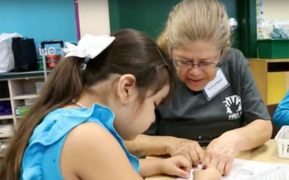
Opportunity 4. Building potential

Slide 9
Reference
Encore.org

